Slide 1
CHAPTER 5
I/O PRINCIPLE
Understand the principles of System Bus
Understand the I/O Principles, its control and respond
Understand the using of IRQ and DMA and differentiate it purposes.
Understanding System Resources

Slide 2
System Bus
    sYSTEM BUS
At the heart of the computer is the microprocessor system:
CPU (central processing unit), also called a processor
Memory circuits — ROM and RAM — containing programs and data
I/O circuits controlling
Bus: subsystem transfer data between computer components inside a computer or between computer.

Slide 3
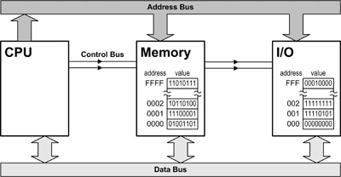
I/O PRINCIPLE
broadcast the location it wishes to read from (or write to).
trigger a read or write operation, and select either memory or I/O.
Data is sent to/from the CPU.

Slide 4
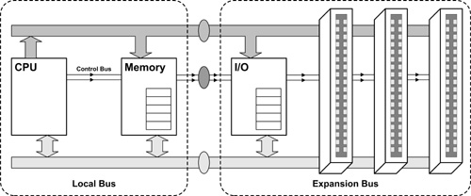
Expansion & Local Bus
Local bus : section of the system bus that connects CPU & memory . Some graphic cards directly into local bus because it faster that normal expansion bus

Slide 5
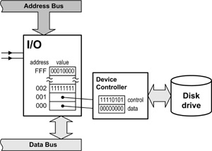
CONTROLLING I/O DEVICES
Control & data registers
Device Controller
Device controllers are usually operated by use of a control register (which selects the mode of operation) and a data register (which carries data to / from the device).
I/O Addresses
unique addresses for device controller

Slide 6
I/O Addresses
Port I/O (port mapped)
Use separated set of addressed is used for I/O devices.
Memory mapped I/O
Use wire I/O devices directly into memory addressed
Remove the special I/O instructions
But decreased the amount address of RAM and ROM

Slide 7
RESPONDING TO I/O DEVICES
Polling
The simplest method
The CPU checks the control register at regular intervals, looking for a specific code.
However, most of the time the device will have nothing to report.
Inefficient and poor technique.
Interrupt
The better solution
Install an interrupt wire feeding back to the CPU.
When a device is ready to report back it sends a signal along this wire (part of the control bus).
The CPU pauses its current task and deals with the device; it then resumes what it was doing.
Interrupt service routine (part of the device driver) - the program code that deals with the device

Slide 8
IRQ (Interrupt request line)
www.pccomputersnotes.com
IRQ special pathways directly to processor that a device use to get attention of the CPU when it needs to.
DMA (Direct Memory Access)
Allow specific devices such as hard disk, CD ROMs, tape drive & sound cards to access memory directly without having pass through CPU.

Slide 9
IRQ (Interrupt request line)
http://en.wikipedia.org/wiki/Interrupt_request
interrupt request (or IRQ) is a hardware signal sent to the processor that temporarily stops a running program and allows a special program, an interrupt handler, to run instead.
Interrupts are used to handle such events as data receipt from a modem or network, or a key press or mouse movement

Slide 10
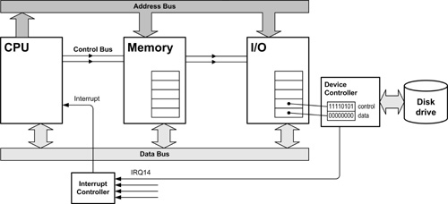
IRQs CONCEPTS
There are many devices but only one interrupt wire.
PCs use an interrupt controller chip to create multiple interrupt wires, each fed to a different device.
When a device signals an interrupt the chip triggers the main interrupt wire and tells the CPU which device has called, allowing the appropriate service routine to be carried out.
Lines go through an interrupt controller (chipset) that checks information before passing to CPU.
Each line has specific number.

Slide 11
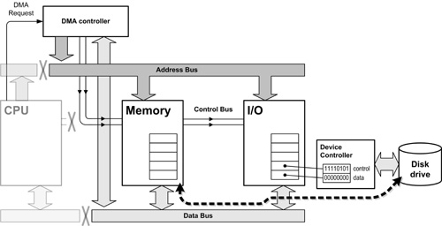
DMA CONCEPT
When large blocks of data need to be transferred between a device and main memory, the CPU sends a signal to a special chip called the DMA controller.
This chip disconnects the CPU, hijacking the system bus, and juggles bus signals to feed data directly from I/O to memory (or from memory to I/O).
When finished, control is handed back again to the CPU.

Slide 12
DMA
www.pccomputersnotes.com
Faster data transfers
Every device need own the channel , If two devices are assign the same DMA it will no write memory properly and caused resource conflict and freeze system.

Slide 13
Serial Transmission
Data is transmitted, on a single channel/single data wire, one bit at a time one after another at regular intervals.
Slower but more effective over longer distances and require fewer wires.
  Each bit is sent over a single wire, one after the other
  Usually no signal lines are used to convey clock (timing information)
Sender transmitted
Receiver received
1
0
0
1
1
0
0
1

Slide 14
Parallel Transmission
each bit has it’s own piece of wire along which it travels
often used to send data to a printer.
Parallel transmission is obviously faster, in that all bits are sent at the same time, whereas serial transmission is slower, because only one bit can be sent at a time. Parallel transmission is very costly for anything except short links.
1
0
0
1
Receiver received
Sender transmitted
1
0
0
1
All bits are sent simultaneously

Slide 15
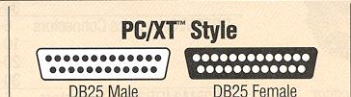
Male and Female Connectors
Pins
Holes
Typical
parallel port
Typical
serial port
Source Black Box

Slide 16
Types of serial transfer
Synchronous (where data words are sent continuously and the clock pulse accompanies the data signal)
Asynchronous (where data words are sent at irregular intervals)

