Slide 1
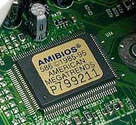
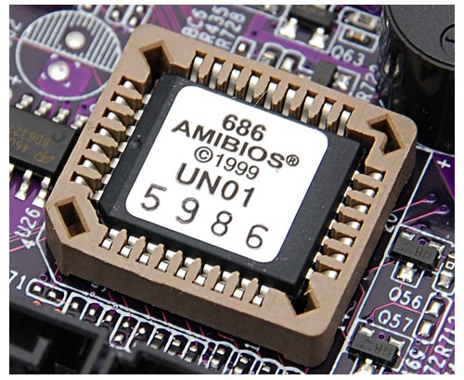
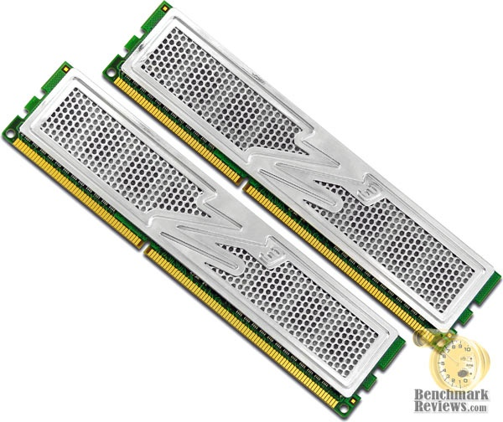
Chapter 4:
MEMORY

Slide 2
OBJECTIVES:-
To explain what memory is and the functions.
To differentiate between volatile (RAM) and non-volatile memory (ROM)
To identified and differentiate certain types of physical memory
To explain on the types of memory use and the latest technology
To identified the slot use for some of the memory module

Slide 3
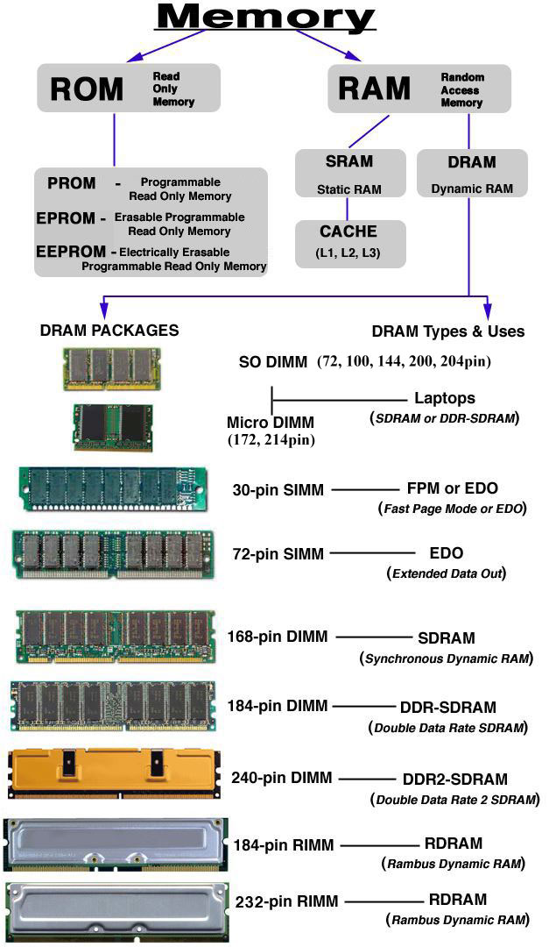

Slide 5
ROM
uses wires to form a grid of rows and columns which are linked at chosen points.
A voltage is placed on a selected row (determined by the address) and the column scanner outputs the detected voltage as a binary number.
Links represent '1' and no-links represent '0'.
ROM
PROM
EPROM
EEPROM
FLASH ROM

Slide 6
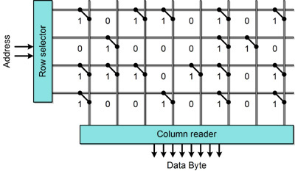
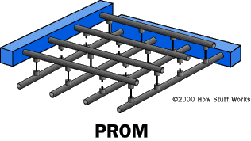
PROM: HOW ROM WORKS???
PROM chips are mass-produced with fuses linking all rows and columns (i.e. '1' in every location).
By sending large voltages along row and column wires, individual fuses can be blown, removing the link.
In this way a computer designer can "blow" or "burn" an entire chip with any program or data they desire, at low cost.

Slide 7
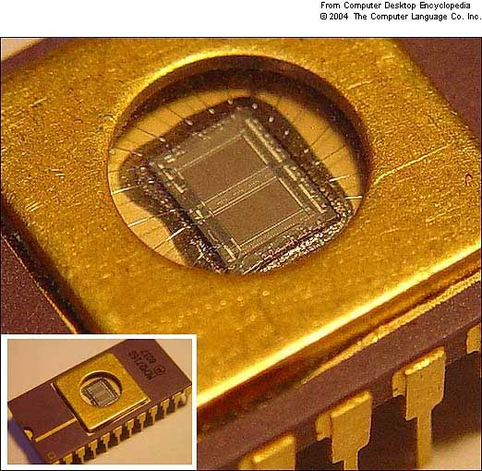
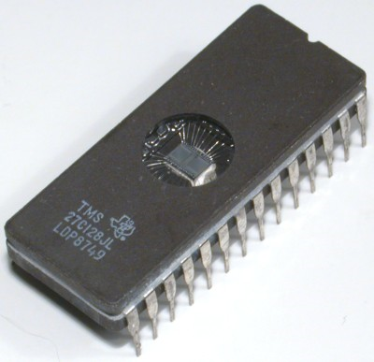
EPROM
fuses are made from chemicals that respond to ultra-violet (UV) light.
When UV shines on the grid, any "blown" fuses will re-form, resetting the chip to its original unused state.

Slide 8
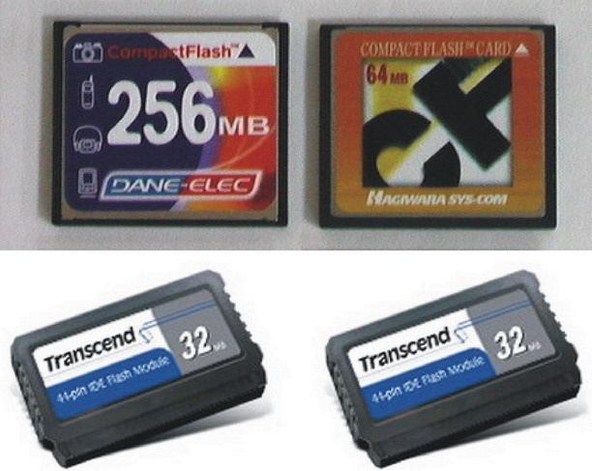

EEPROM
can be re-programmed in situ, (on the motherboard)
It can be wiped without needing to be removed and placed under UV light).
Disadvantage of EPROM & EEPROM
The reprogrammed process will erase all data.
FLASH MEMORY
an improved form of EEPROM
can be erased in sections

Slide 9
RAM
SRAM
DRAM
uses small transistor circuits known as flip-flops (also called latches) to store individual bits.
extremely expensive(transistor)
Usage: cache memory (fast but expensive)
uses electronic capacitors to store electrical charge
Charge = 1, No Charge = 0
needs to be refreshed at regular intervals
Usage: main memory (cheap to manufacture but slower)
DRAM – asynchronous (ns)
SDRAM( Synchronous DRAM) (Hz)

Slide 10
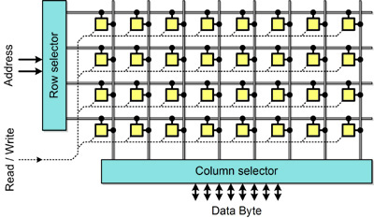
Like ROM, RAM is organized into rows and columns.
At each crossover, however, is an electronic device capable of storing a single bit of information.

Slide 11
Comparing DRAM and SRAM
Type | Speed | Density | Cost
DRAM | Slow | High | Low
SRAM | Fast | Low | High

Slide 12
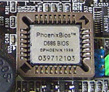
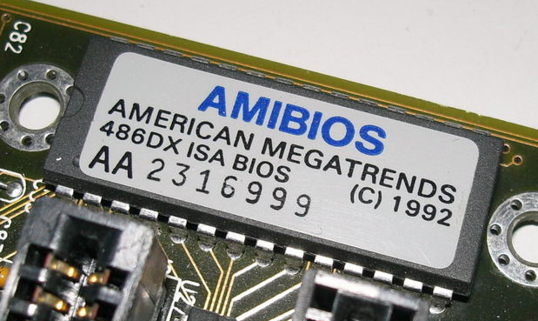
MEMORY : BIOS ROM
BIOS = Basic Input/Output System
Bios is a program runs when the PC is started.
Functions:-
To check the status of the motherboard circuitry.
To prepare the system ready for the DOS.
To allow access to the computer's settings stored in CMOS memory

Slide 13
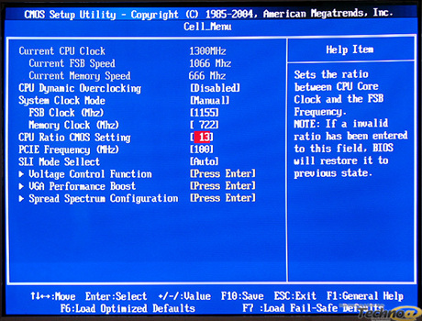
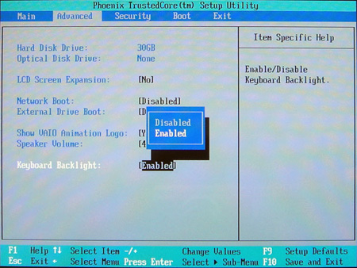
MEMORY : CMOS MEMORY
was slower but used less power.

Slide 14
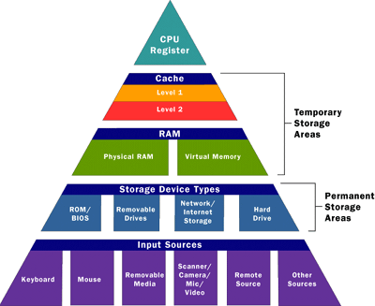
MEMORY : CACHE
Build from SRAM
sits between the CPU and the main memory.
Cache controller : monitors the addresses that are requested by the CPU
Predicts which memory will be required in the future
Data is read into the cache memory in advance, allowing the computer to obtain data far more quickly from the cache than from the main memory.

Slide 15
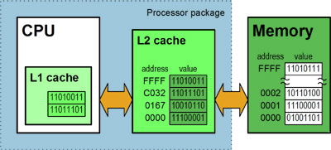
L1 (Level 1) : built into the main processor circuit.
L2 (Level 2) : built into the main processor circuit or on processor socket.
L3 (Level 3) : motherboard cache, build on motherboard.

Slide 16
MAIN MEMORY MODULE/PACKAGE
The type of board and connector used for RAM in desktop computer.
Different computer manufacturers developed memory boards that would only work with their specific systems.
3 types of memory module.
SIMMS - Single Inline Memory Module
DIMMS - Dual Inline Memory Module
RIMMS - Rambus Inline Memory Module

Slide 17

SIMMS
Used for early Pentiums.
2 sizes : 30-pin (8 bits wide) &72pin (32 bits wide)
needed to be installed in banks (groups of 2 or 4)
Parity – extra error checking
Examples:
FPM DRAM - Fast Page Mode (waits the entire process)
EDO DRAM - Extended Data Outburst (Do not waits the process) – faster than FPM.

Slide 18
DIMMS
Small outline DIMMs (SODIMMs) - used for laptops
64 bits, 168 pin connector.
Examples:
SDRAM
Synchronous DRAM
synchronized to the system's FSB clock pulse
More quickly than EDO RAM.
DDR & DDR2
Double Data Rate
works at twice the speed of conventional SDRAM
DDR-2 – faster form of DDR.

Slide 19
DDR 3
DDR3 SDRAM, an abbreviation for double data rate type three synchronous dynamic random access memory, is a modern kind of dynamic random access memory (DRAM) with a high bandwidth interface, and has been in use since 2007
o transfer data at twice the rate.
enabling higher bandwidth

Slide 20
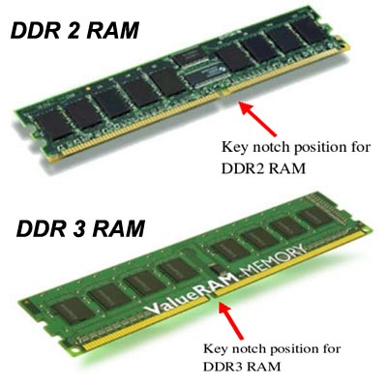

Slide 21
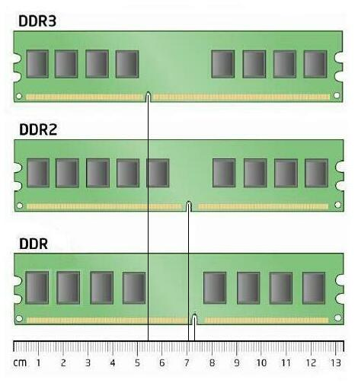
DDR 3 : 5.5CM
DDR 2: 7CM
DDR : 7.25

Slide 22
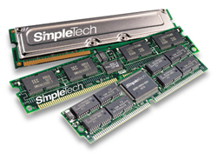
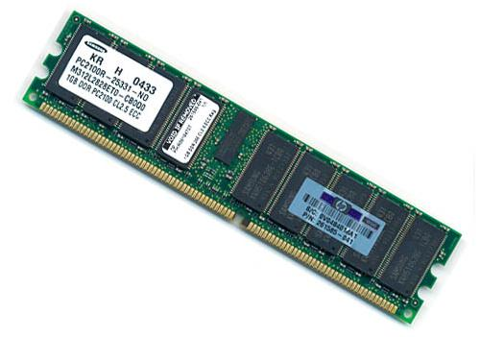
ECC - Error-Correcting Code Memory (server)
Unbuffered or Registered
Dual channel
Many motherboards support dual channel memory
increase the speed as accessing two DIMMs simultaneously but requires performance-matched DIMMs.

Slide 23
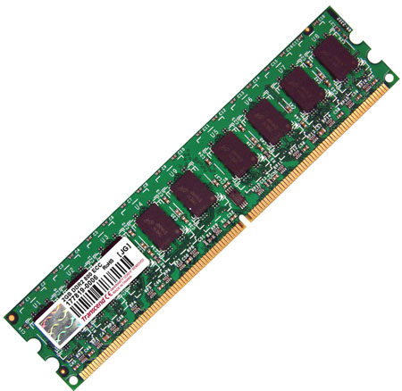
2GB DDR2-800 ECC Unbuffered memory modules

Slide 24
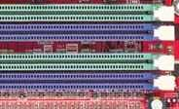
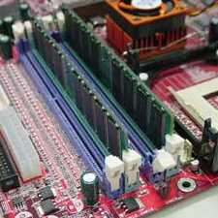
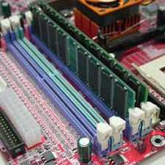
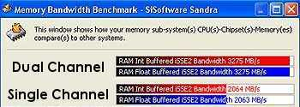
DIMMS 1
DIMMS 2
CHANNEL A
DIMMS 3
CHANNEL B
DIMMS 4
Single Channel
Dual Channel

Slide 25
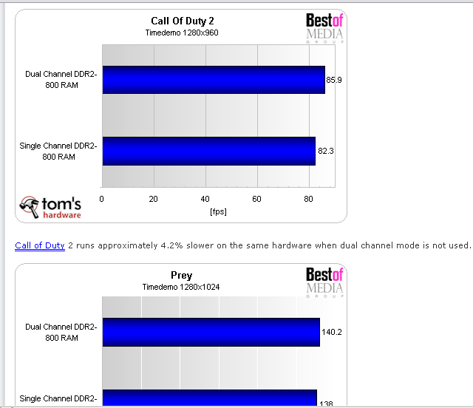

Slide 26
Single channel or dual channel?
2.66GHz Northwood, 512KB L2, 533MHz FSB, No Hyperthreading
512MB DDR266 RAM (2 x 256MB Modules) in "dual channel" (533MHz)
--------------------------
to this set-up:
--------------------------
3.2GHz Prescott, 1024KB L2, 800MHz FSB, with Hyperthreading
512MB DD400 RAM (1 x 512MB Module) in "single channel" (400MHz)

Slide 27
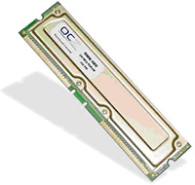
RIMMS
used by Intel on early Pentium 4 systems
184-pin boards similar to DIMMs in appearance, with heat spreader cases.
transfer only 16 bits at a time but at very high speed.
Very Expensive

Slide 28
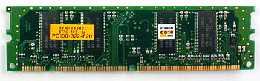

SIMM
DIMM
SODIMM

Slide 29
ThE EnD

