Slide 1
Ports

Slide 2
Port - Interface between the computer and other computers or devices.
1 way transmission data from second device
Bi- directional (2 way comm)
Parallel port
Serial port

Slide 3
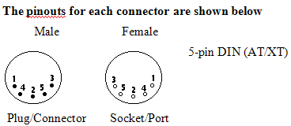
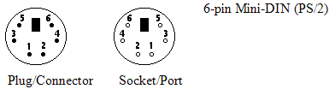
PS/2
Keyboard or mouse port.

Slide 4


USB (Universal Serial Bus)
can connect computer peripherals such as mouse devices, keyboards, PDAs, gamepads and joysticks, scanners, digital cameras and printers.
The USB icon, found on all USB plugs.
Device components: Any external storage /printer/scanner
Type-B USB port Type-A USB port

Slide 5


FireWire(Apple) / i.Link(Sony)
serial bus interface standard, offering high-speed communications and isochronous real-time data services.
The FireWire icon, found on all FireWire USB plugs.
Device components: Video camera
The 6-pin and 4-pin FireWire.

Slide 6

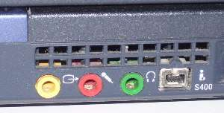
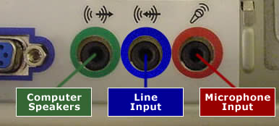
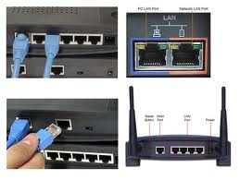

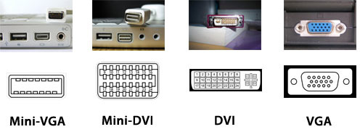
SYMBOL’S NAME
DEVICE/COMPONENTS
Earphone port
Earphone/speaker
Audio In
Earphone/speaker
LAN / Network port
RJ45/CAT5e cable
VGA/Display
Monitor/projector

Slide 7
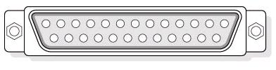
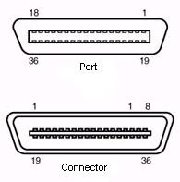
Parallel Printer Port
used to connect printers and other add-on items such as external CD-ROM drives, external tape drives, and scanners.
Standard 25-pin D connector / DB-25 connector
Centronic connector and port

Slide 8
Serial Port (COM port/RS-232 port)
Use for attaching modem, other computers, UPS (uninterruptible power supply) and barcode readers or for configuring Network equipment such as manageable switches and routers.

Slide 9



Standard 9-pin D-sub connector / DE-9 connector
DB-15
DB-15HD

Slide 10
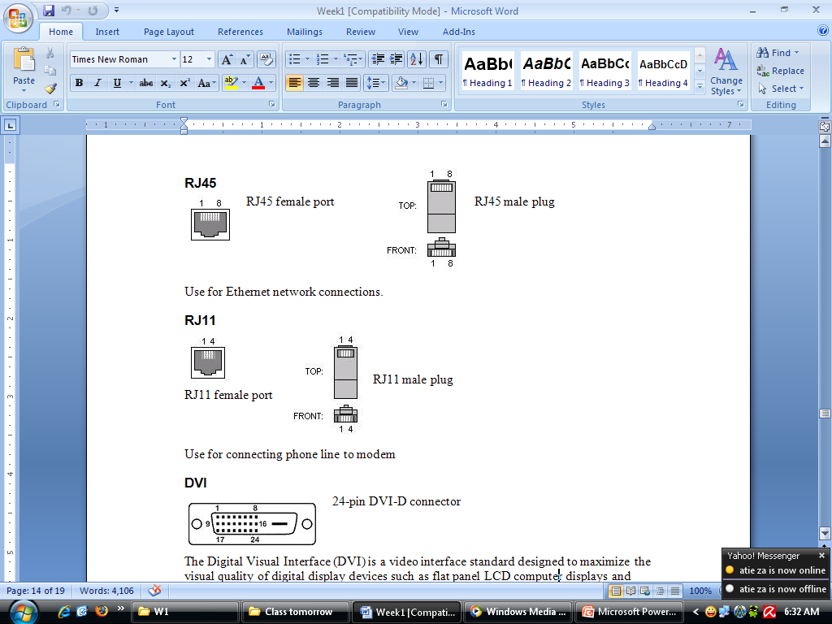

Slide 11

24-pin DVI (Digital Visual Interface)

Slide 12
Expansion Slot
Expansion slot standards
PCI Express
PCI
PCI-X
AGP

Slide 13
Expansion Slot
Expansion cards type
Graphics cards
Sound cards
Network cards
TV tuner cards
Modems
Host adapters such as SCSI, RAID, SATA controllers, Firewire (universally known as I/O card)
POST cards
Physics cards, only recently became commercially available.
Video processing expansion cards

Slide 14


PCI (Peripheral Component Interconnect)
Expansion Card Type – all
rear of system front of system
PCI-X (Peripheral Component Interconnect Extended)
Expansion Card Type– Network Card and Host adapter card.
rear of system front of system

Slide 15
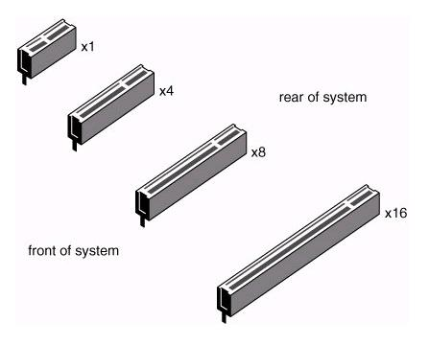
PCI Express (PCIe)
Expansion Card Type – all

Slide 16
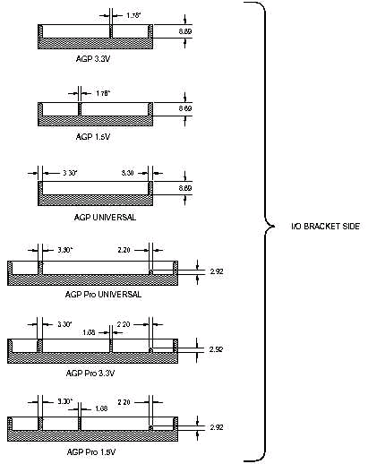
AGP(Accelerated Graphics Port/Advanced Graphic Port)
Expansion Card Type – Graphic Card (3D)

Slide 17
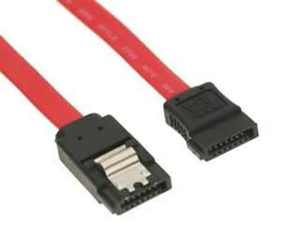
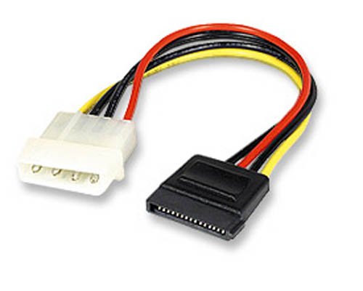
Storage Interface

Slide 18
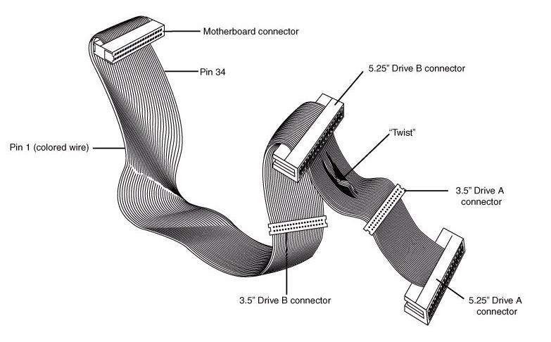
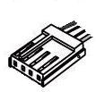
Storage Interface
Floppy Disk Drive (FDD) power cable (Berg connector)
Floppy Disk Drive (FDD) data cable

Slide 19
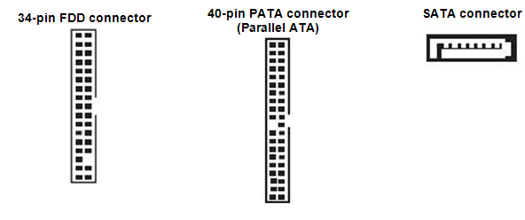
Storage Interface (on motherboard)

Slide 20
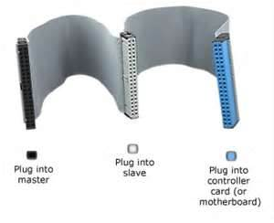
PATA ribbon

